Slide 1

Session on CyberSecurity
Mrs. Deepthi Vuchuru
Associate Vice President – ICS Risk
Information & Cyber Security Department,
Standard Chartered Bank - India

Slide 2
Contents
Introduction
CIA Triad
What is Cyber Security
Cyber Security Attacks
Security Best Practices
Q&A Session

Slide 3

Introduction
Associate Vice President in ICS Risk & Control Department in Standard Charted Bank
19+ years of exp. In Information & Cyber Security (ICS) domain
B.Sc. – Physics ( batch 2nd rank holder)
M.S.W – Human Resource Management
Certified Information Security Manager- ISACA ( secured in top ten global percentile)
Certified Information Security Auditor – ISACA
ISO 27002-2023 Lead Auditor – ISO ( secured Gold Certificate)
Certification in AWS Cloud Practitioner
Certification in Cyber Security – CISCO Network Academy
NASSCOM CyberSecurity Ambassador effective from 2022
Certification in Toastmasters Speechcraft Program
Deepthi Vuchuru

Slide 4
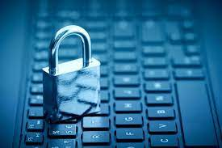
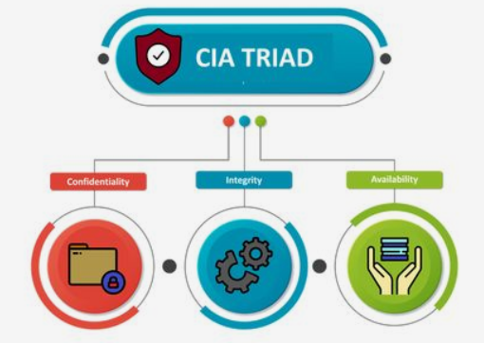
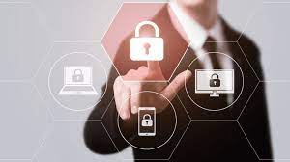

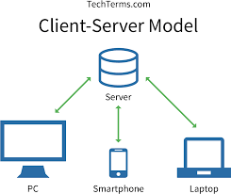
CIA Triad

Slide 5
Fundamentals of Information Security
Confidentiality
Integrity
Availability
Non-repudiation
Security Policies
Security Controls
Security Awareness and Training
Incident Response
Compliance
Continuous Monitoring

Slide 6
What is Cybersecurity
cybersecurity = security of information systems and networks with an aim of protecting information, operations and assets from various internal and external threats, attacks, accidents, failures and errors etc.
availability, integrity and confidentiality

Slide 7
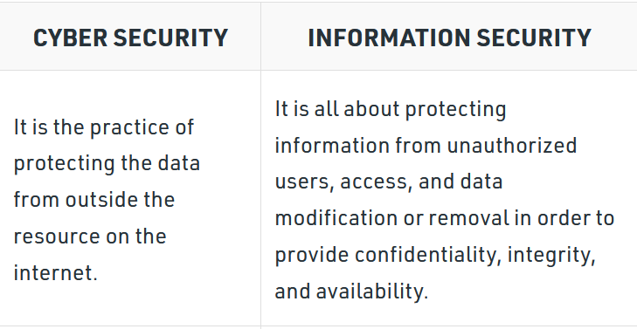
Cybersecurity Vs Information Security

Slide 8
Vulnerability, threat and risk
Vulnerability – Network, OS, Human & Process
Threat – Intentional, unintentional and natural
Malicious act which exploits the vulnerability
Risk – External & Internal
Potential consequence of the loss or damage of assets or data caused by a cyber threat
Flaw in a system’s design, security procedures, internal controls

Slide 9
Cybersecurity Basic Attacks
Cyber threats
Malware
Virus , Worms and Trojans.
Phishing
Phishing is a type of cyber attack that involves tricking individuals into revealing sensitive information, such as login credentials, financial data, or personal information.
Ransomware
Ransomware is a type of a cyber attack that encrypts a victim's files, making them inaccessible until a ransom is paid. Once the ransom is paid, the attacker may provide a decryption key to restore the files.

Slide 10
Cybersecurity Attacks
1. Social Engineering
This attack involves the psychological manipulation of people into performing actions or divulging confidential information. A type of confidence trick for the purpose of information gathering, fraud, or system access.
2. Brute force
It is a type of attack which uses a trial and error method. This attack generates a large number of guesses and validates them to obtain actual data like user password and personal identification number. This attack may be used by criminals to crack encrypted data, or by security analysts to test an organization's network security.
3. Dictionary attacks
This type of attack stored the list of a commonly used password and validated them to get original password.
4. Tailgating
Gaining unauthorized physical access to secure areas by following authorized personnel

Slide 11
Cybersecurity Attacks
Web-based attacks
5. Injection attacks
It is the attack in which some data will be injected into a web application to manipulate the application and fetch the required information.
6. Man in the middle attacks
It is a type of attack that allows an attacker to intercepts the connection between client and server and acts as a bridge between them. Due to this, an attacker will be able to read, insert and modify the data in the intercepted connection.
7. Session Hijacking
It is a security attack on a user session over a protected network. Web applications create cookies to store the state and user sessions. By stealing the cookies, an attacker can have access to all of the user data.

Slide 12
Laws , Regulatory Bodies & Standards on CyberSecurity
General Data Protection Regulation (GDPR) - EU
Sarbanes-Oxley (SOX ) – US regulation
Graham-Leach-Bliley act (GLBA) – US Regulation
Health Information Portability and Accountability Act ( HIPAA)
Payment Card Industry Data Secucrity Standard (PCI-DSS)
Securities Exchange Commission (SEC)
Data Protection Act ( DPA) – UK
National Institute of Standards & Technology - NIST
Information Technology Act 2000 ( IT Act 2000) – India
Digitial Personal Data Protection Act 2023 – India
National Cyber Security Policy (NCSP) 2013- India
Reserve Bank of India
Securities and Exchange Board ( SEBI ) of India

Slide 13
Phishing – How to be vigilant
Check the Sender's Email Address
Look for Poor Grammar and Spelling Mistakes
Avoid Clicking on Suspicious Links
Don't Download Attachments Without Verification
Verify Requests for Sensitive Information
Look for Urgency or Threats
Pay Attention to Email Formatting

Slide 14
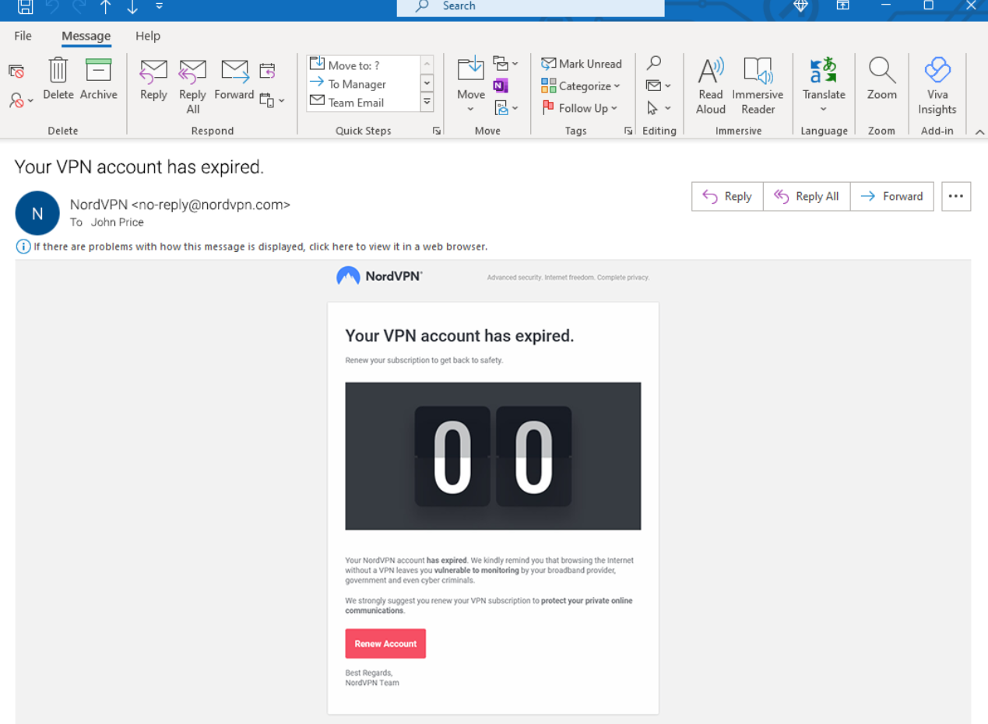
Phishing Simulations

Slide 15
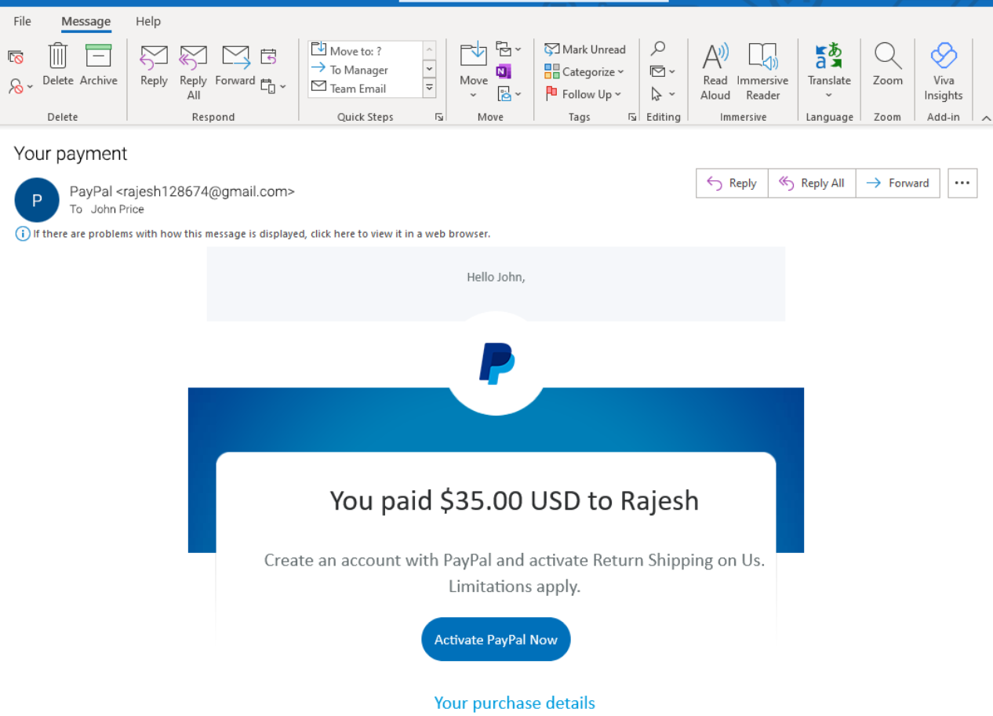
Contd..

Slide 16
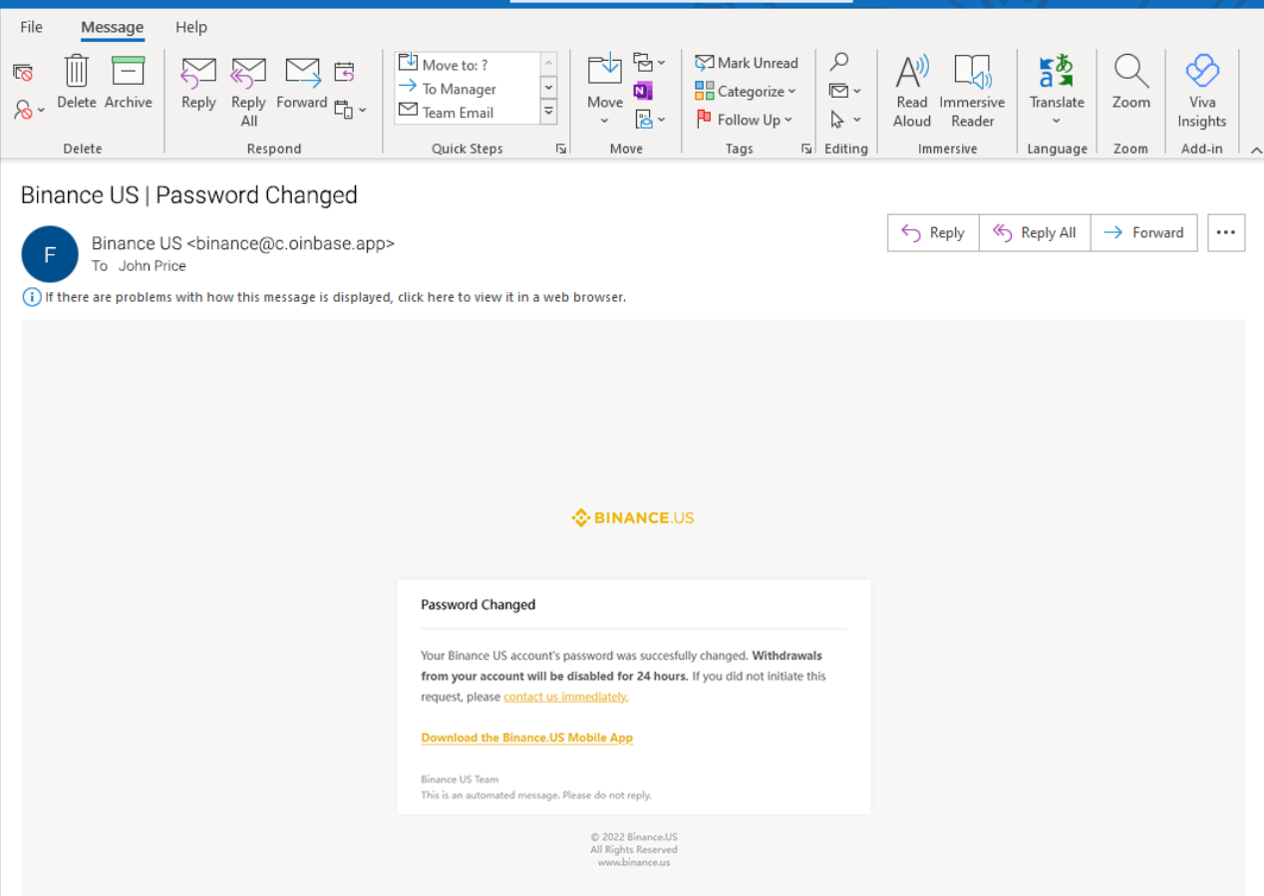
Contd..

Slide 17
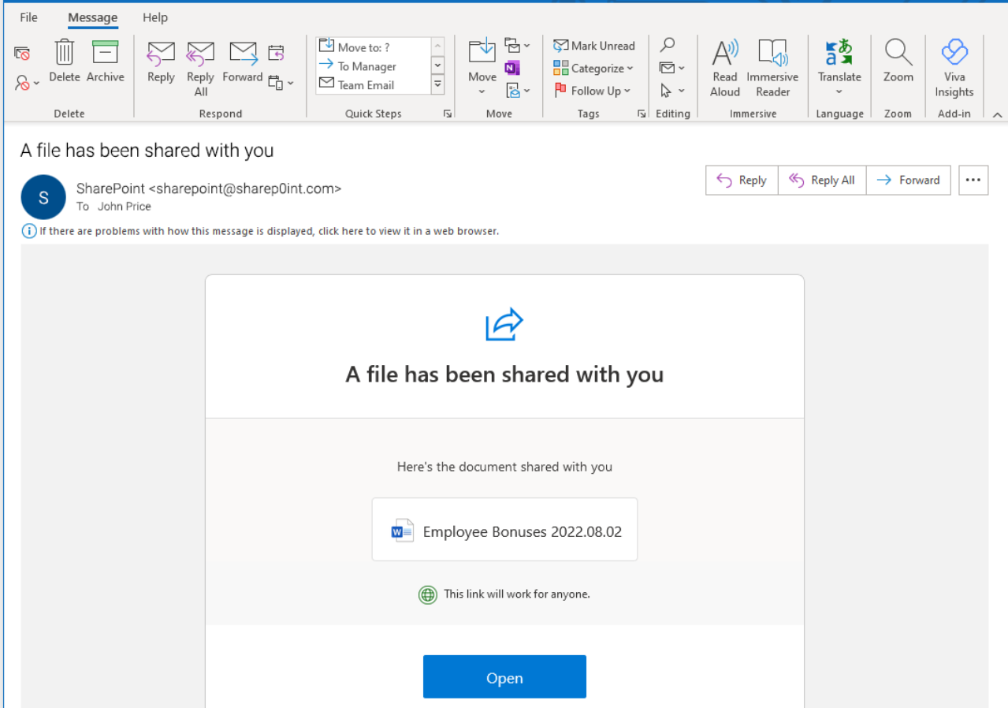
Contd..

Slide 18
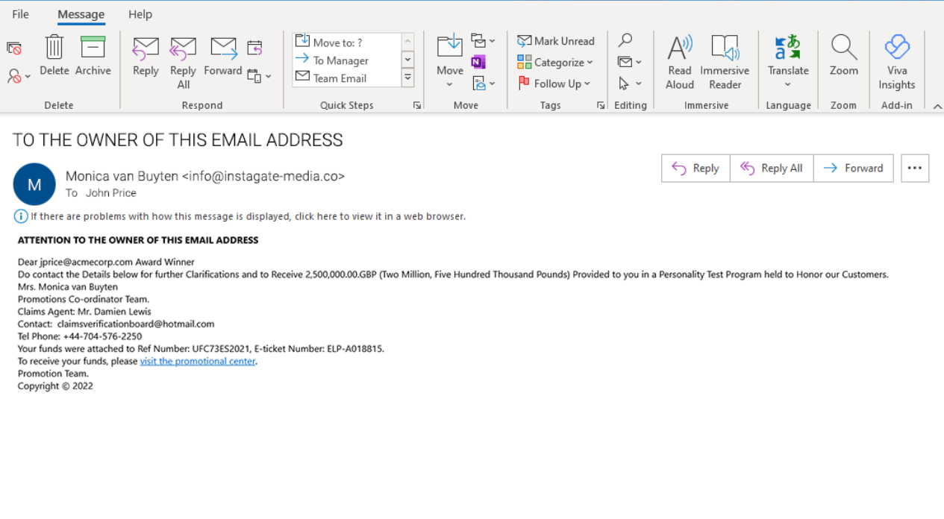
Contd..

Slide 19
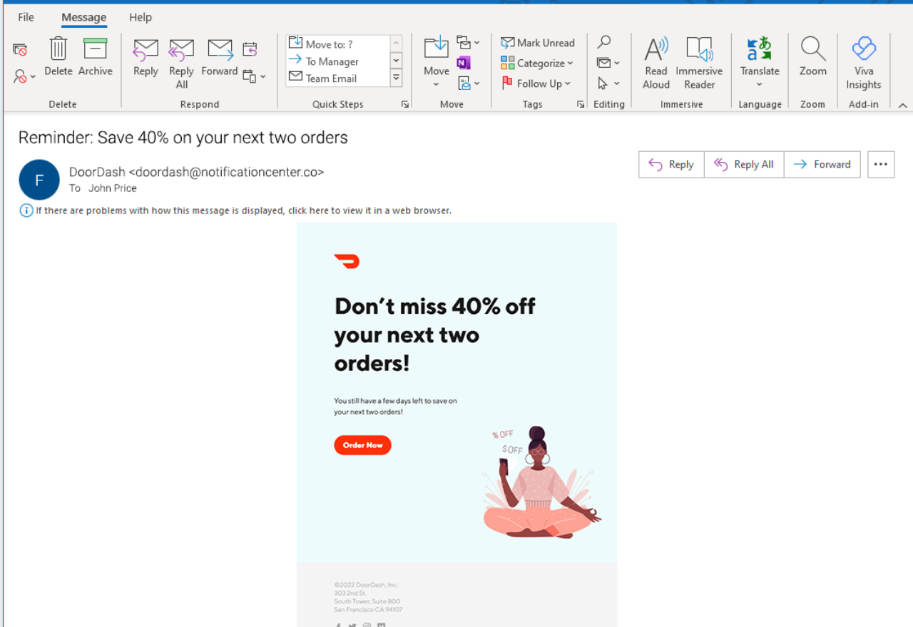
Contd..

Slide 20
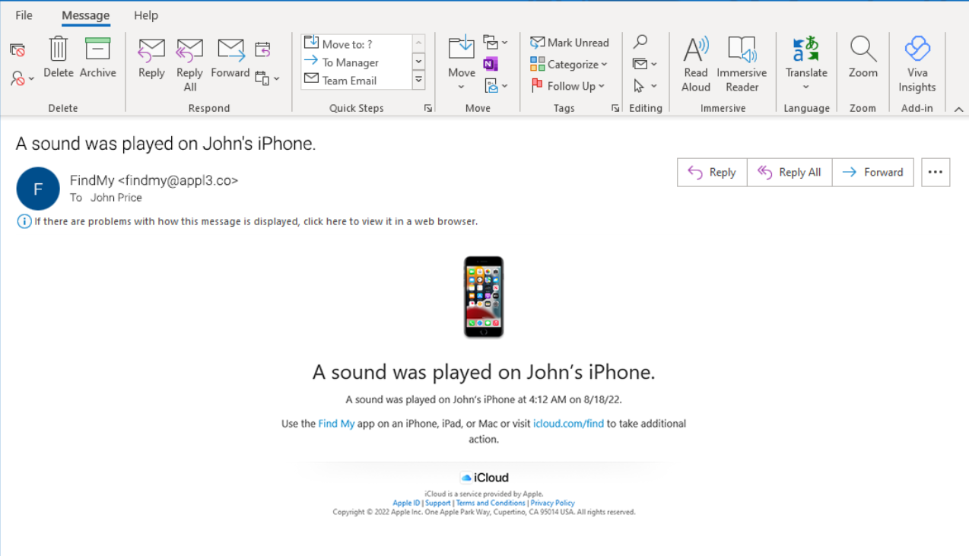
Contd..

Slide 21
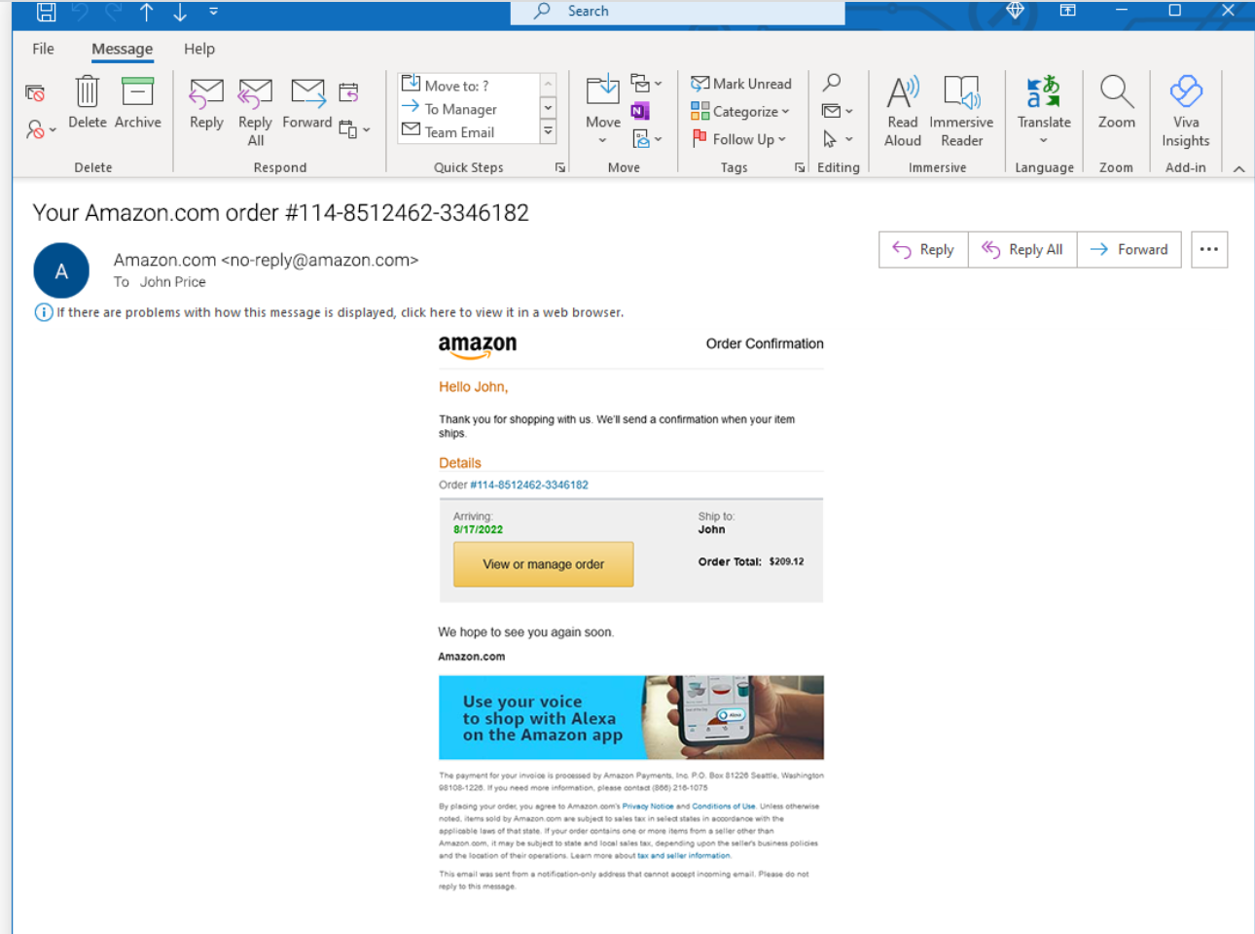
Contd..

Slide 22
Threat Intelligence and Cyber Defense Frameworks
Importance of Threat Intelligence in Cybersecurity:
Threat intelligence provides real-time insights into emerging threats, enabling organizations to proactively identify and mitigate risks before they result in breaches or disruptions.
Overview of Cyber Defense Frameworks:
Cyber defense frameworks offer structured approaches to cybersecurity, providing guidelines, best practices, and controls to help organizations build robust defense strategies and mitigate cyber risks effectively.
Incorporating Threat Intelligence into Cyber Defense Strategies:
Integrating threat intelligence into cyber defense strategies enhances situational awareness, enables proactive threat detection, and facilitates timely response actions, strengthening overall security posture and resilience against evolving threats.

Slide 23
Key Benefits
Proactive Defense: Threat intelligence shifts your mindset from reactive to proactive:
Anticipate attacks: Know what methods are likely to be used against your organization.
Harden defenses: Prioritize patches and updates based on real-world threats, not just generic vulnerabilities.
Improve threat detection rules: Refine your security tools to detect known and developing attack patterns.
Faster Incident Response: Detect attacks earlier in their lifecycle and take containment action.
Recognize IOCs: IOC feeds integrated with your security tools can aid in swift detection.
Understand attack context: Knowledge of an attacker group's methods helps piece together the attack faster.
Better Decision Making: Justify security investments and make informed choices.
Resource Allocation: Allocate budget based on real risks, not just fear or hype.
Prioritize remediation: Focus on patching systems most likely to be targeted.
Mature Security Operations: Elevate your security team's effectiveness.
Reduce alert fatigue: Focus on relevant alerts, not just any noisy detection.
Empower threat hunting: Armed with intelligence, analysts can proactively search for threats hidden in your network.

Slide 24
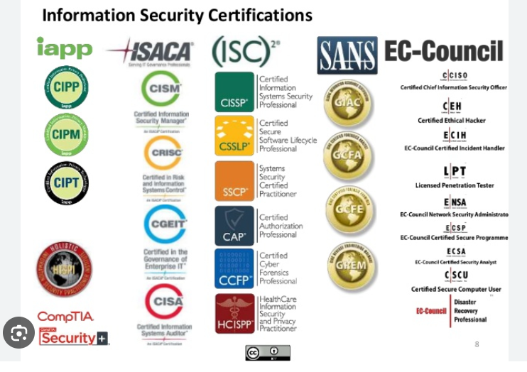

Slide 25
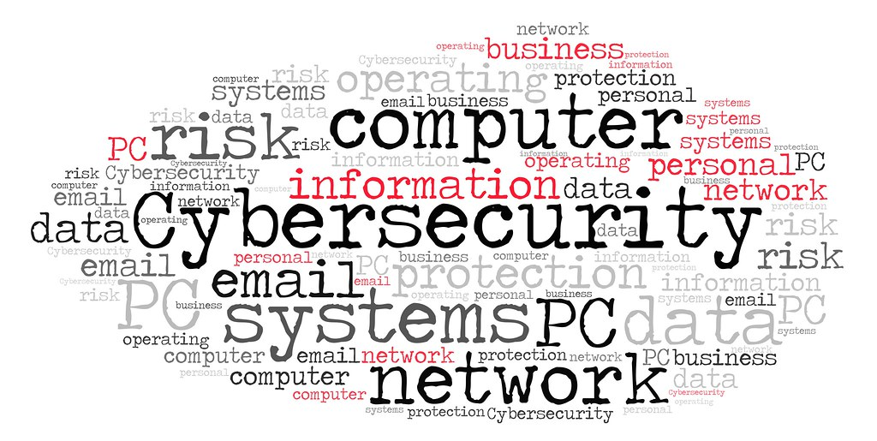
Q&A
This Photo by Unknown Author is licensed under CC BY

